Slide 1


US Craft Beers and Breweries
I.A.WILDS
Samuel VonPaays Soh

Slide 2

Evaluating the data

Slide 3
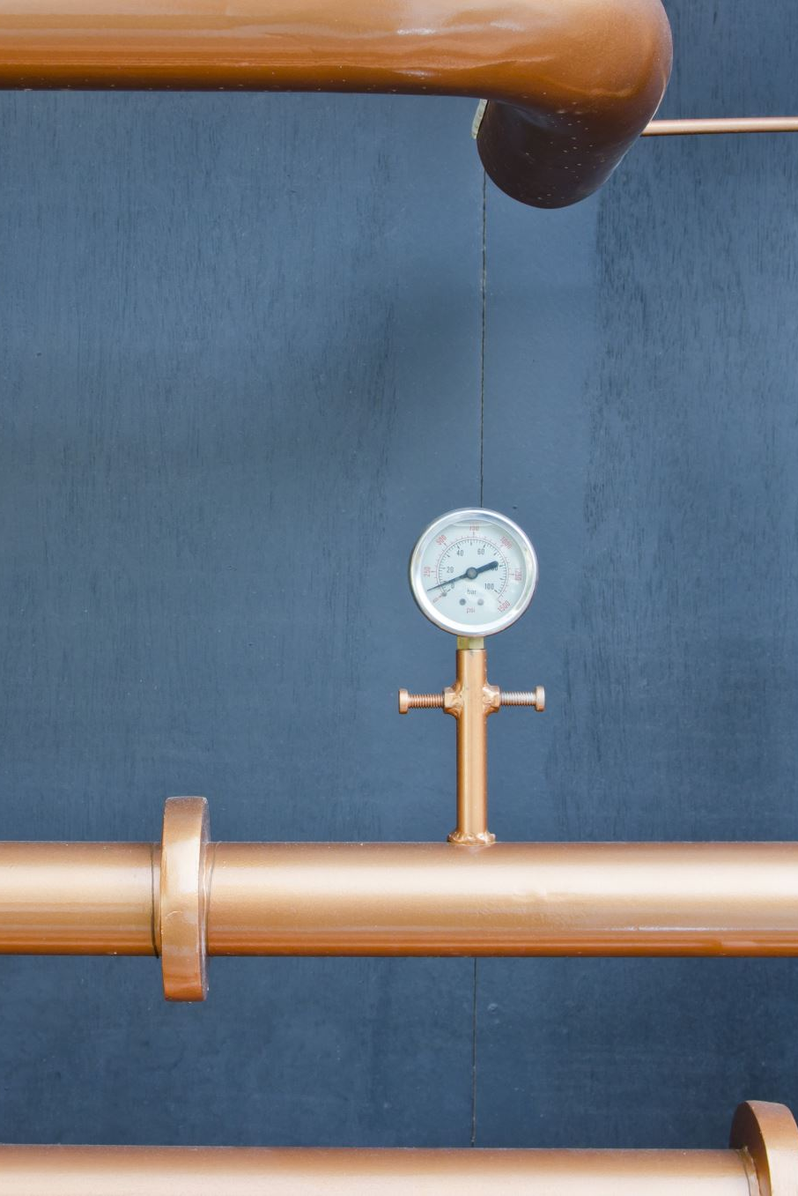
2410 US craft Beers
Name: Name of the beer.
Beer_ID: Unique identifier of the beer.
ABV: Alcohol by volume of the beer.
IBU: International Bitterness Units of the beer.
Brewery_ID: Brewery id associated with the beer
Style: Style of the beer (IPA, Ale, Amber, etc.)
Ounces: Ounces of beer.

Slide 4
558 US BREWERIES
Brew_ID: Unique identifier of the brewery.
Name: Name of the brewery.
City: City where the brewery is located.
State: U.S. State where the brewery is located.

Slide 5
Number of Breweries by State
AK | 7 | KS | 3 | NM | 4 | WV | 1
AL | 3 | KY | 4 | NV | 2 | WY | 4
AR | 2 | LA | 5 | NY | 16
AZ | 11 | MA | 23 | OH | 15
CA | 39 | MD | 7 | OK | 6
CO | 47 | ME | 9 | OR | 29
CT | 8 | MI | 32 | PA | 25
DC | 1 | MN | 12 | RI | 5
DE | 2 | MO | 9 | SC | 4
FL | 15 | MS | 2 | SD | 1
GA | 7 | MT | 9 | TN | 3
HI | 4 | NC | 19 | TX | 28
IA | 5 | ND | 1 | UT | 4
ID | 5 | NE | 5 | VA | 16
IL | 18 | NH | 3 | VT | 10
IN | 22 | NJ | 3 | WA | 23

Slide 6
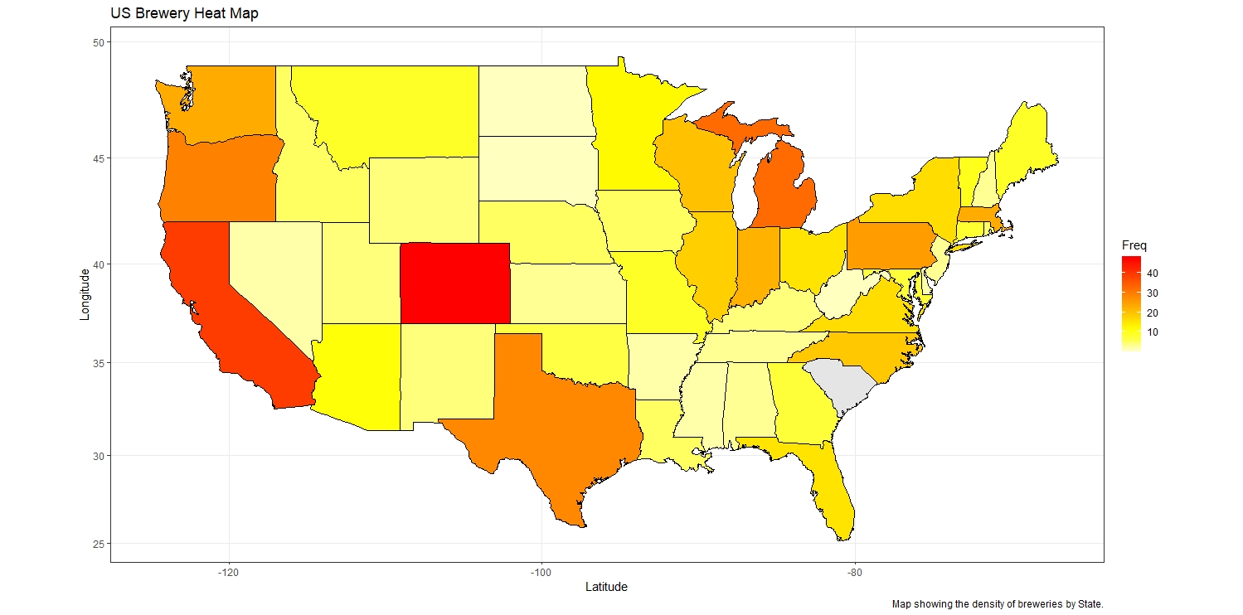
Breweries by State

Slide 7
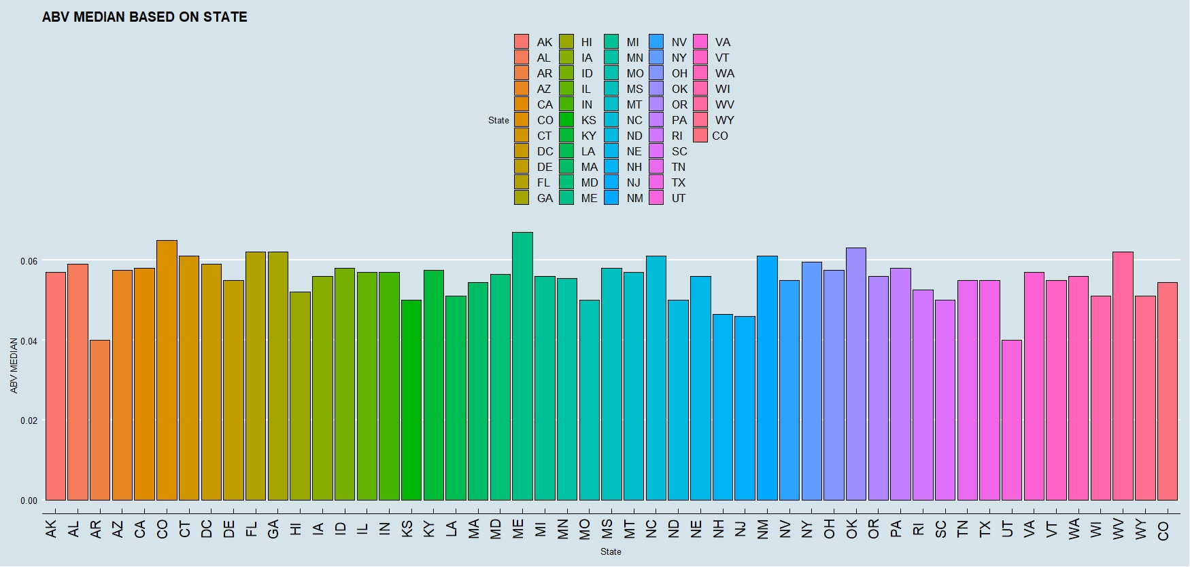
Compute the median alcohol content for each state. Plot a bar chart to compare.

Slide 8
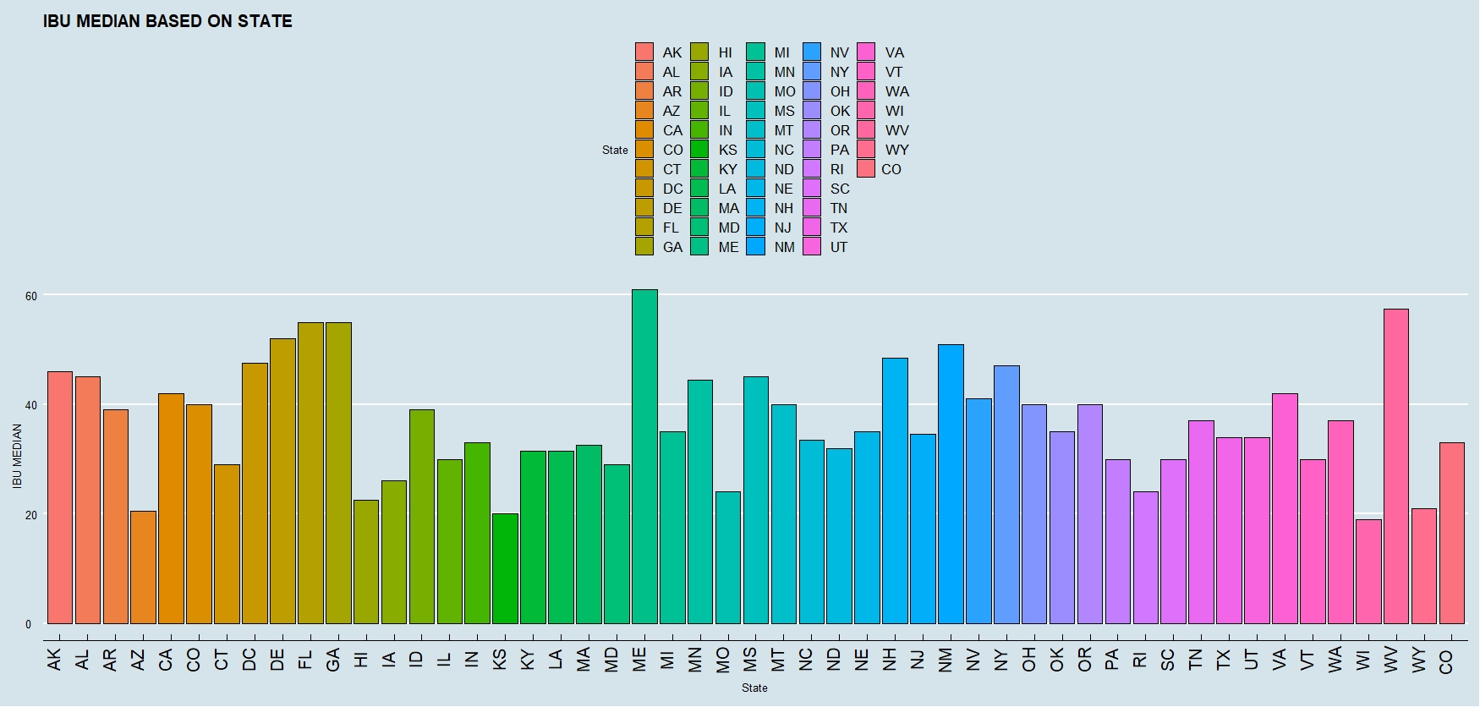
Compute the median international bitterness unit for each state. Plot a bar chart to compare.

Slide 9

US Median values for reference
US Median ABV is 0.056
US median IBU is 35

Slide 10

Addressing the missing values
Missing values or “NA” values were removed from both the IBU and ABV columns.
Sufficient data exists to remove them without negatively affecting the overall dataset.

Slide 11
Max ABV by State
Boulder, CO
Lee Hill Series Vol. 5 - Belgian Style Quadrupel Ale
ABV 0.128

Slide 12
Highest IBU by State
Astoria, OR
Bitter Bitch Imperial IPA IBU 138

Slide 13
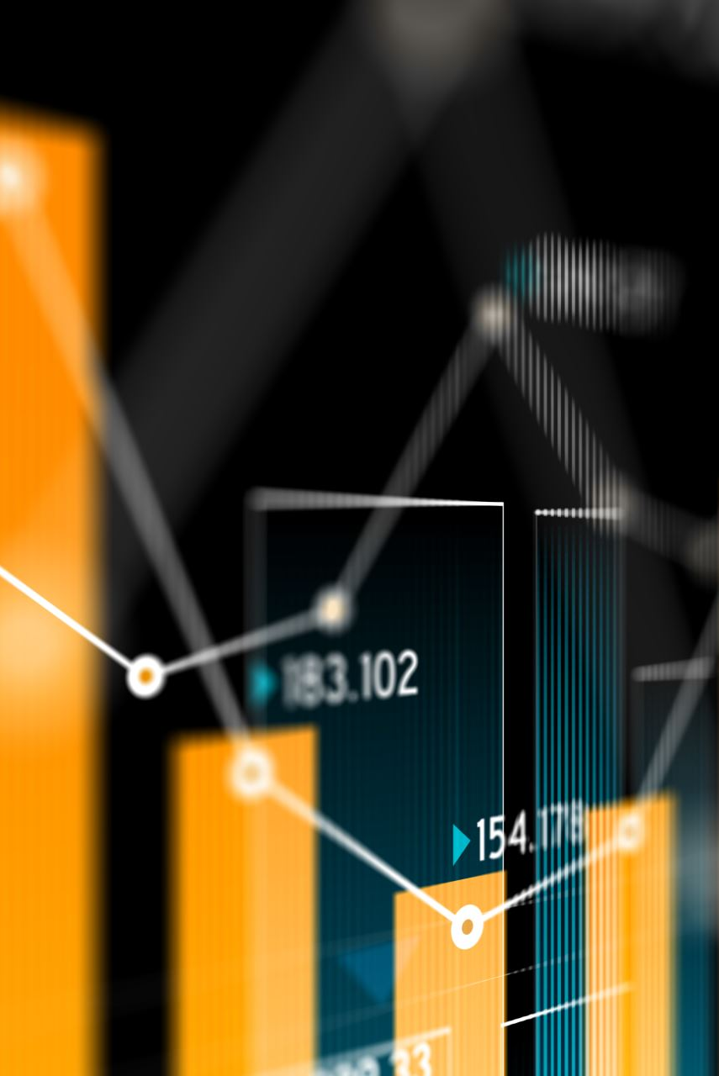
the summary statistics and distribution of the ABV variable
Min. 0.02700 (The lowest value)
1st Qu. 0.05000 (middle number between the smallest number and the median )
Median 0.05700 (the middle value of a set of ordered numbers)
Mean 0.05991 (the average of a set of numbers)
3rd Qu. 0.06800 (middle value between the median and the highest value
Max. 0.12500 (The highest value)

Slide 14
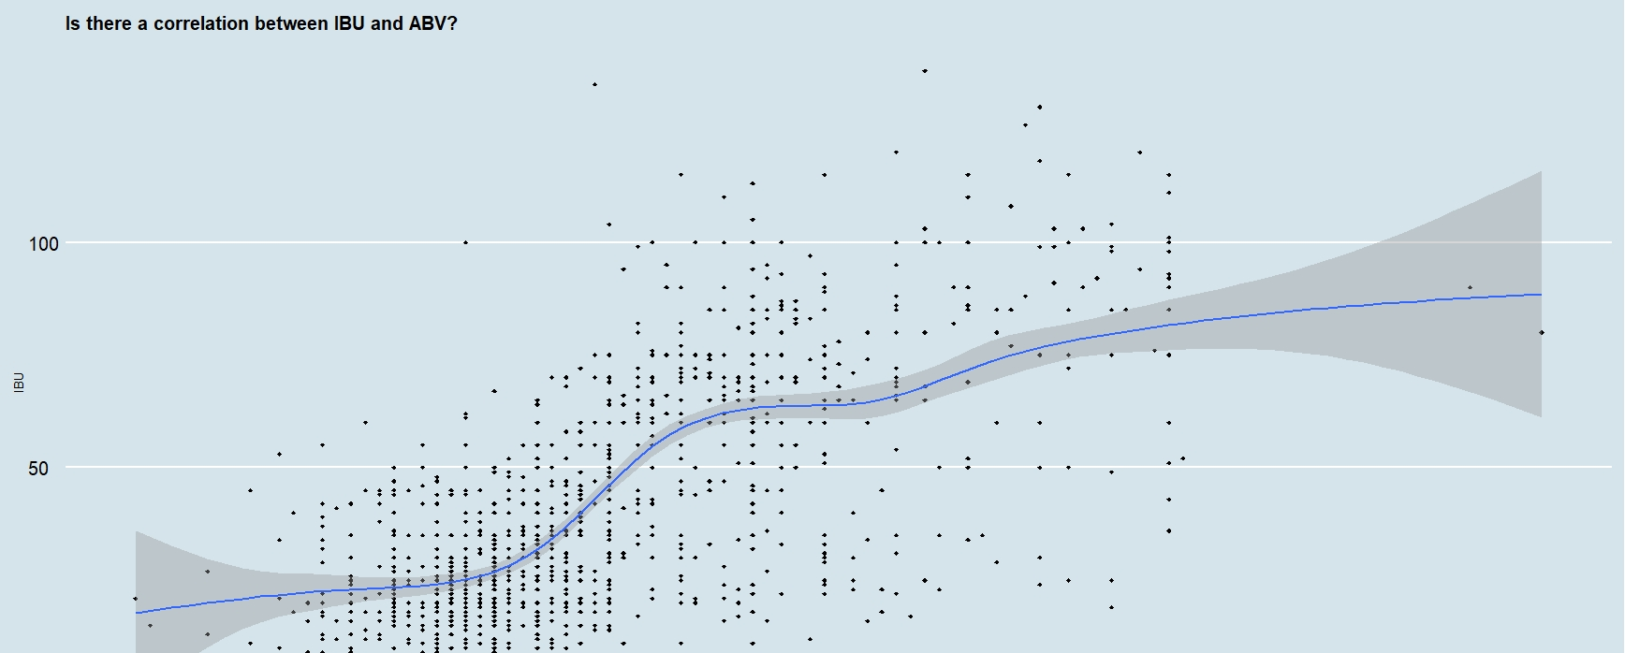
Is there an apparent relationship between the bitterness of the beer and its alcoholic content?

Slide 15
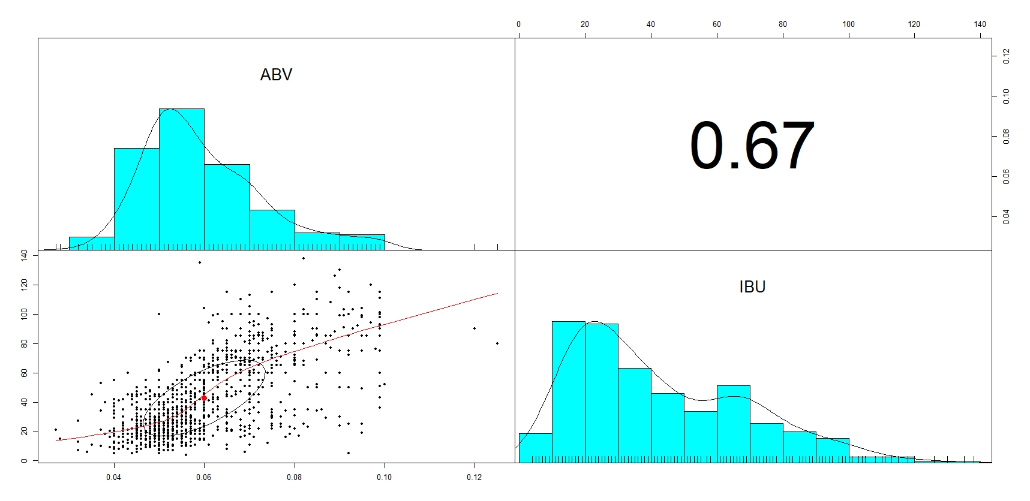

Slide 16

investigating the difference with respect to IBU and ABV between IPAs (India Pale Ales) and other types of Ale.

Slide 17
KNN to contrast IPA and ALe
ALE IPA
ALE 150 31
IPA 13 89
* Accuracy : 0.8445

Slide 18
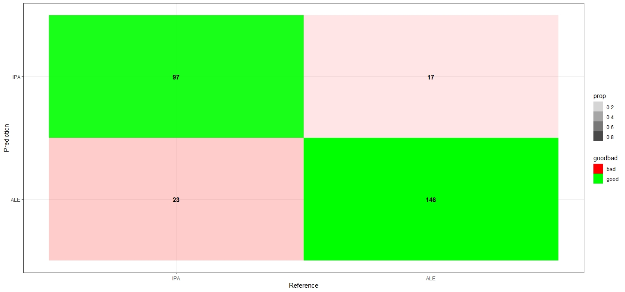
Using Naïve Bayes to supplement the KNN findings

Slide 19
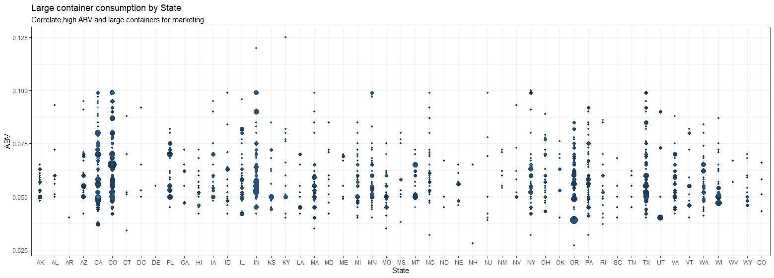
which states tend to prefer larger bottles of beer with higher ABV for marketing purposes

Slide 20
https://youtu.be/LHv7nrqYfAQ
This presentation is available at on YOUTUBE.COM using the link above.

